Slide 1


BOOTSTRAP
Lecture-1

Slide 2
Today’s Agenda
What Is BootStrap ?
What Is Responsive Web Design ?
Why BootStrap ?
History Of BootStrap ?
Configuring Our System For BootStrap

Slide 3
What Is BootStrap ?
Bootstrap is an open-source HTML, CSS, and JavaScript framework for building responsive and mobile-first applications on the web.
By using Bootstrap, we can build responsive websites without rewriting the code for each device or screen.

Slide 4
What Is Responsive Web Design ?
Responsive web design is about creating web sites which automatically adjust themselves to look good on all devices.
It allows our page to work for computer, tablets and mobile phones.

Slide 5

What Is Responsive Web Design ?

Slide 6
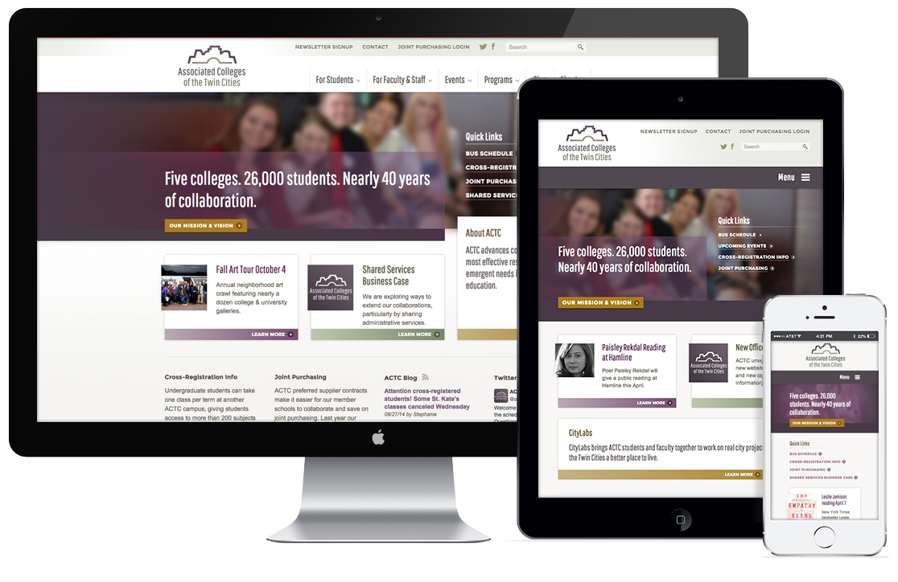
What Is Responsive Web Design ?

Slide 7
Why BootStrap ?
Easy to get started − With just the knowledge of HTML and CSS anyone can get started with Bootstrap. Also the Bootstrap official site has a good documentation.
Browser compatibility: Bootstrap is compatible with all modern browsers (Chrome, Firefox, Internet Explorer, Edge, Safari, and Opera)
Responsive features: Bootstrap's responsive CSS adjusts to phones, tablets, and desktops

Slide 8
BootStrap History
Developed by Mark Otto and Jacob Thornton at Twitter
Originally named Twitter Blueprint
First released on August 19,2011
Bootstrap 2 – January 31, 2012
Bootstrap 3 – August 19, 2013
Bootstrap 4 – October 29, 2014
Bootstrap 5– May 13, 2021
We will be using BootStrap 5.3.2 and will be highlighting the
differences in 4 & 5 as and when required

Slide 9
Ways Of Using BootStrap
In web applications, we can use the Bootstrap framework in different ways, those are:
Download Bootstrap Files
Referencing a Bootstrap from CDN
Package Managers

Slide 10
Downloading BootStrap
We can download the latest version of Bootstrap framework from https://getbootstrap.com/docs/5.3/getting-started/download/
The download files will contain the compiled and minified versions of CSS and JavaScript plugins.
We can include any of these versions i.e. either full or minified version based on our requirements.

Slide 11
Downloading BootStrap
Now, add the downloaded files to the application root directory
Finally, include those file references in header (<head>) section by using src attribute of the <script> tag like as shown in next slide

Slide 12
Adding BootStrap
<!DOCTYPE html>
<html lang="en">
<head>
<title>Bootstrap Example</title>
<!-- Latest Bootstrap CSS -->
<link href="css/bootstrap.css“ rel=“stylesheet”></link>
</head>
<body>
<!– Our HTML Code -->
<!-- jQuery Library -->
<script src=“js/jquery.js"></script>
<!-- Latest Compiled JavaScript -->
<script src="js/bootstrap.bundle.js"></script>
</body>
</html>

Slide 13
Using BootStrap From CDN
In case, we don’t want to download the bootstrap files, then we can directly add it to our webpage by referencing it from public CDN (Content Delivery Network).
Visit the following link and copy the CDN links mentioned there and paste them as shown in the next slide
CDN Links Page: https://getbootstrap.com/docs/5.3/getting-started/download/

Slide 14
Using BootStrap From CDN
<!DOCTYPE html>
<html lang="en">
<head>
<title>Bootstrap Example</title>
<!-- Latest Bootstrap CSS -->
<link rel="stylesheet" href="https://cdn.jsdelivr.net/npm/bootstrap@4.5.3/dist/css/bootstrap.min.css" integrity="sha384-TX8t27EcRE3e/ihU7zmQxVncDAy5uIKz4rEkgIXeMed4M0jlfIDPvg6uqKI2xXr2" crossorigin="anonymous">
</head>
<body>
<script src="https://code.jquery.com/jquery-3.5.1.slim.min.js" integrity="sha384-DfXdz2htPH0lsSSs5nCTpuj/zy4C+OGpamoFVy38MVBnE+IbbVYUew+OrCXaRkfj" crossorigin="anonymous"></script>
<script src="https://cdn.jsdelivr.net/npm/popper.js@1.16.1/dist/umd/popper.min.js" integrity="sha384-9/reFTGAW83EW2RDu2S0VKaIzap3H66lZH81PoYlFhbGU+6BZp6G7niu735Sk7lN" crossorigin="anonymous"></script>
<script src="https://cdn.jsdelivr.net/npm/bootstrap@4.5.3/dist/js/bootstrap.min.js" integrity="sha384-w1Q4orYjBQndcko6MimVbzY0tgp4pWB4lZ7lr30WKz0vr/aWKhXdBNmNb5D92v7s" crossorigin="anonymous"></script>
</body>
</html>

Slide 15
BootStrap Starter Template
To create a bootstrap web page template, we need to do the following:
Include HTML5 doctype at the beginning of the page
Add viewport meta tags for proper responsive behavior

Slide 16
BootStrap Starter Template
<!DOCTYPE html>
<html lang="en">
<head>
<!-- Required meta tags -->
<meta charset="utf-8">
<meta name="viewport" content="width=device-width, initial-scale=1">
</head>
<body>
………
</body>
</html>

Slide 17
Why DOCTYPE ?
We have included HTML5 doctype at the beginning of the page because the Bootstrap requires HTML5 doctype to render HTML elements and CSS properties without any styling problems.

Slide 18
Lang And Charset
Along with HTML 5 , we also have added the lang and charset attributes
They are needed to specify the language and char encoding for the HTML document.

Slide 19
Viewport
As discussed, the Bootstrap framework built with mobile-first strategy to make sure that the design is responsive for mobile devices.
So, to ensure proper rendering and touch zooming for all devices we included viewport meta tag in <head> element.

Slide 20
Device Width And Scale
Here, the width=device-width part is useful to adjust the page width based on the screen width of the device
Similarly , the initial-scale=1 part is useful to set the initial zooming level whenever the page is first loaded by the browser.

Slide 21
Adding BootStrap Files
Along with the above meta tags, we need to include required Bootstrap CSS and JS files to convert the above HTML template to bootstrap template.
The code for the same is shown on the next slide

Slide 22
Final Template
<!DOCTYPE html>
<html lang="en">
<head>
<meta charset="UTF-8">
<meta name="viewport" content="width=device-width, initial-scale=1.0">
<link rel="stylesheet" href="css/bootstrap.css">
<title>BootStrap Example</title>
</head>
<body>
<h1>Hello, world!</h1>
<script src="js/jquery.js"></script>
<script src="js/bootstrap.bundle.js"></script>
</body>
</html>

